Slide 1
Introduction to i4Trust and i4Trust Data Spaces

Slide 2
Train the Trainers: The Practicalities

Slide 3
Train the Trainers - Calendar (Sessions 9:00-12:00 CEST on Airmeet)
MONDAY 26 Apr | TUESDAY 27 Apr * | WEDNESDAY 28 Apr * | THURSDAY 29 Apr * | FRIDAY 30 Apr
Introduction to i4Trust Data Spaces, building blocks and roles | NGSI-LD primer Smart Data Models | i4Trust components for Identity Management and Access Control i4Trust Marketplace | Bringing the pieces together | Open Q&A Technical Business
 |  |  | Detailed walkthrough of the reference example
MONDAY 3 May | TUESDAY 4 May * | WEDNESDAY 5 May | THURSDAY 6 May | FRIDAY 7 May
PRACTICAL EXERCISES | NGSI-LD: advanced operations | PRACTICAL EXERCISES | PRACTICAL EXERCISES | Open Q&A Technical Business
MONDAY 10 May | TUESDAY 11 May * | WEDNESDAY 12 May * | THURSDAY 13 May | FRIDAY 14 May
Ecosystem Building | Connecting to legacy systems, IoT and other systems | Creating Data Processing Services | PRACTICAL EXERCISES | PRACTICAL EXERCISES
Onboarding The role of DIHs
MONDAY 17 May | TUESDAY 18 May | WEDNESDAY 19 May | THURSDAY 20 May | FRIDAY 21 May
PRACTICAL EXERCISES | Community Support for trainees - Tier 1, 2, 3 | PRACTICAL EXERCISES | EXAMINATIONS | EXAMINATIONS
* Sessions for LEBDs

Slide 4
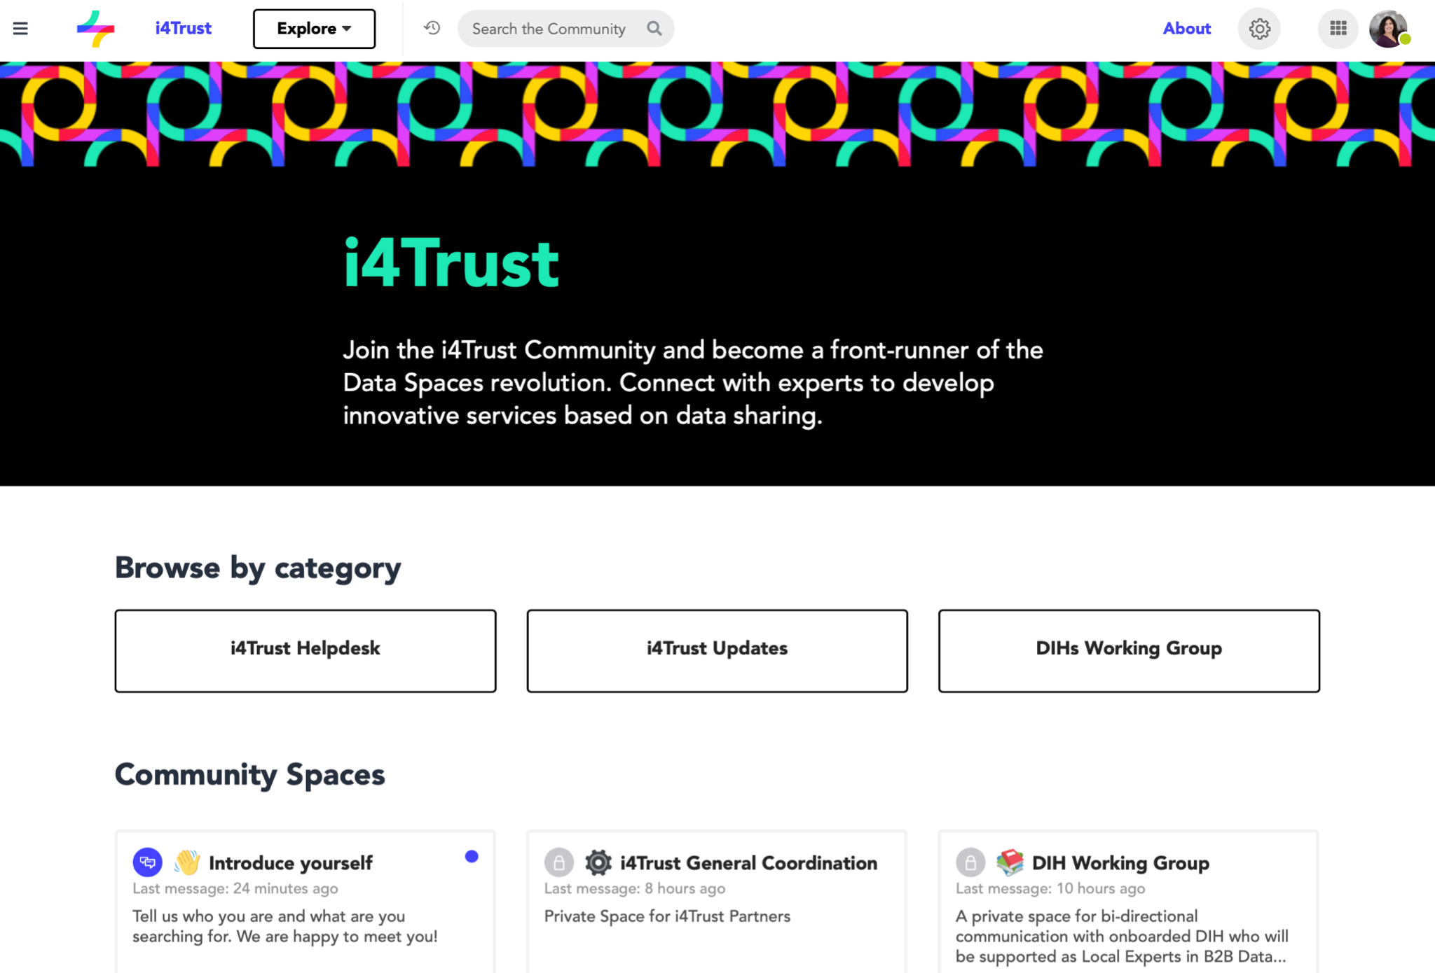
i4Trust Community spaces & DIH Working Group
https://spaces.fundingbox.com/c/i4trust

Slide 5

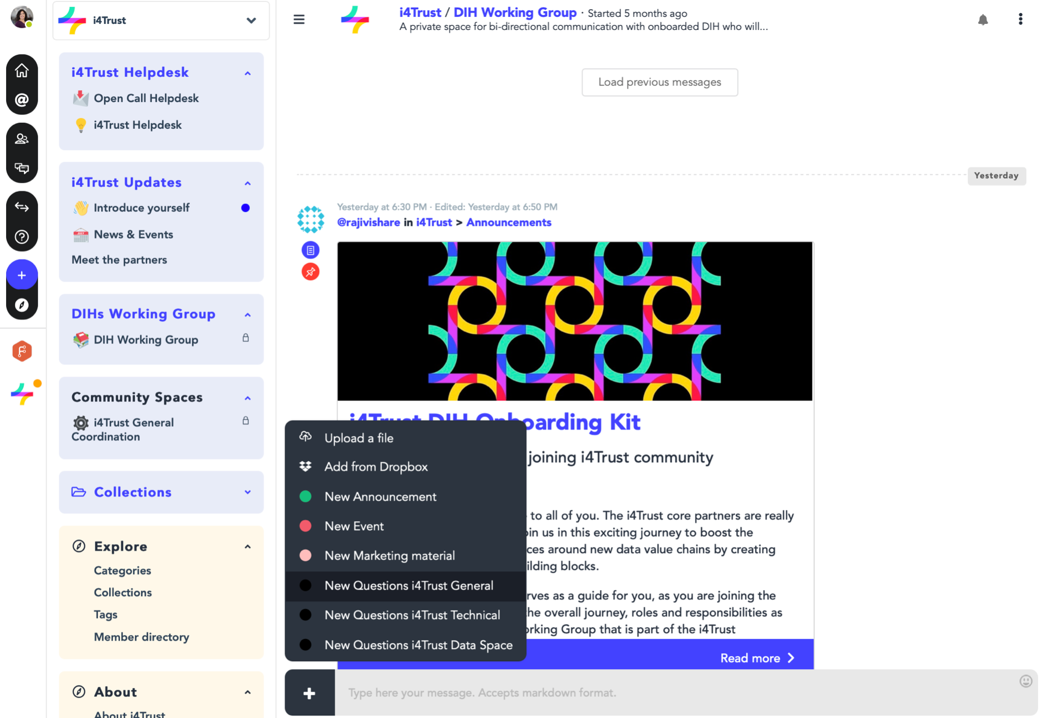
DIH Working Group & Questions
DIHs Working Group
https://spaces.fundingbox.com/spaces/i4trust-dih-working-group

Slide 6
Connecting on Social Media
Website: https://i4trust.org
Twitter @I4Trust
LinkedIn: https://www.linkedin.com/company/i4trust/
Youtube: “i4Trust Project” https://www.youtube.com/channel/UCScal9eWPmKfs-VZrurDLFg
Hashtags:
#i4trust
#i4TrustCommunity
#TraintheTrainers
#dataspaces
#opendata
#opensource
#datasharing
#datamodels
#digitaltwins
#datavaluechain
#datamarketplace

Slide 7
Session 1 - Introduction to i4Trust
Speakers:
Juanjo Hierro - CTO FIWARE Foundation
Gerard van der Hoeven - Executive Director iSHARE Foundation
Rosa Villaronga - Project Manager Funding Box

Slide 8
i4Trust overall mission and vision

Slide 9
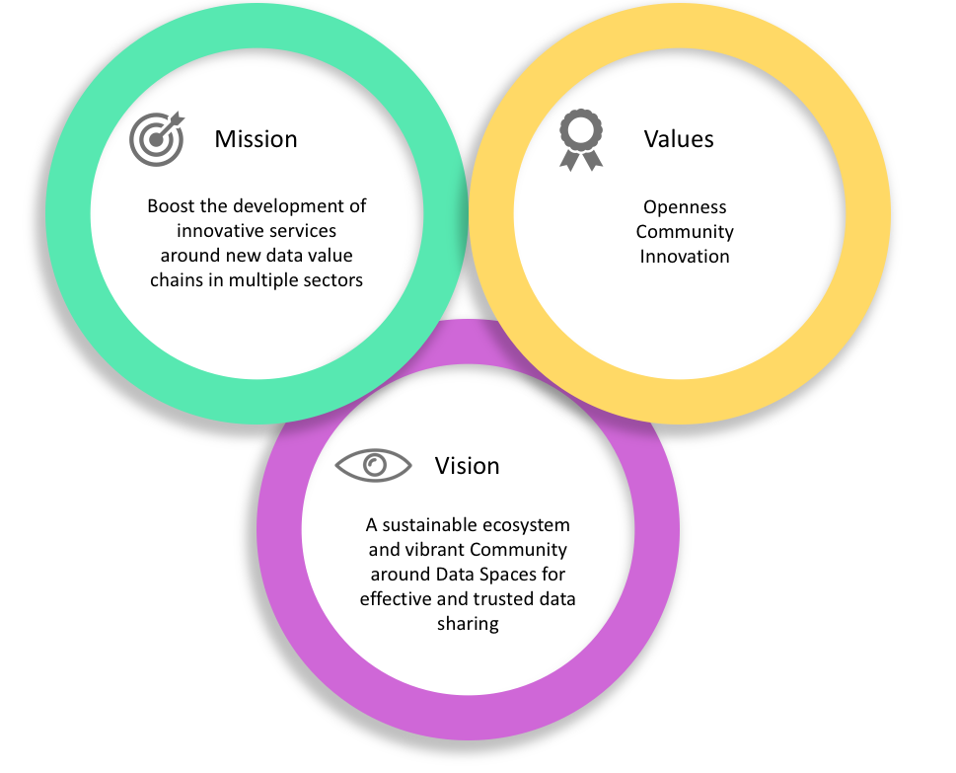
i4Trust Mission, Vision, Values
Trustworthiness
Sovereignty
Effectiveness
Cross-domain
Innovation
Growth
Openness
Notes:
Explain the vision, mission and values of i4trust project.
Vision: Our Vision is to develop a sustainable ecosystem and vibrant community of Data Spaces for effective and trusted data sharing.
Mission: Our mission is to boost the development of innovative data driven services across the value chains and we would achieve this by providing tools, mentorship and structure for creating data sovereign data spaces.
Oppennes
Community
Meritocracy

Slide 10
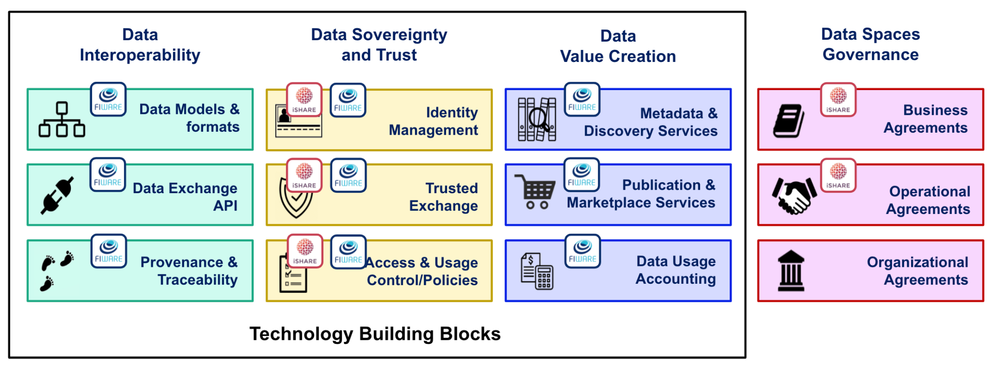
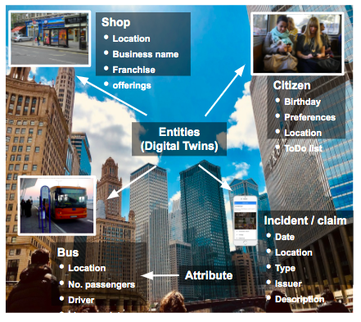
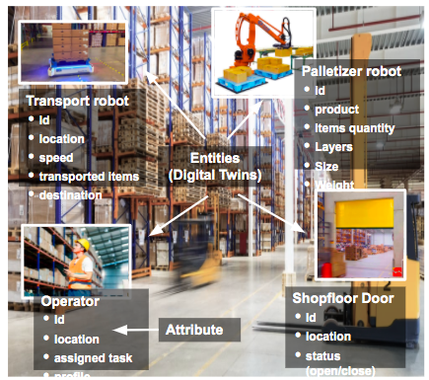
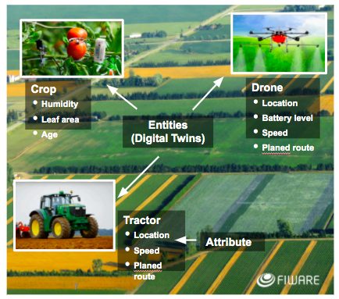
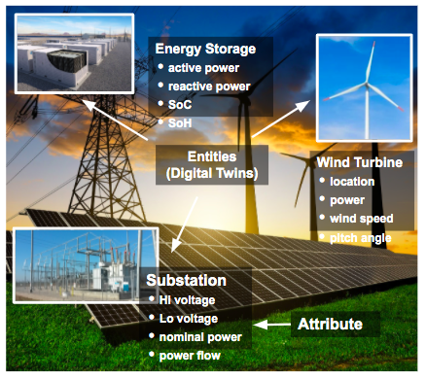


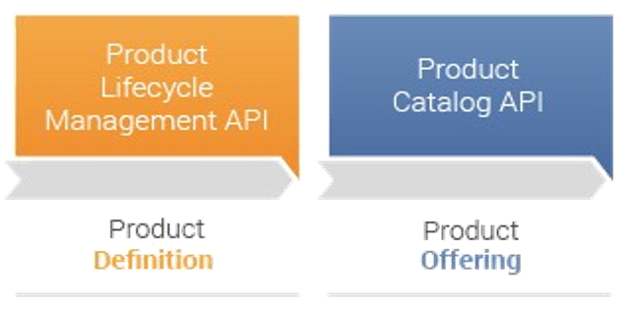
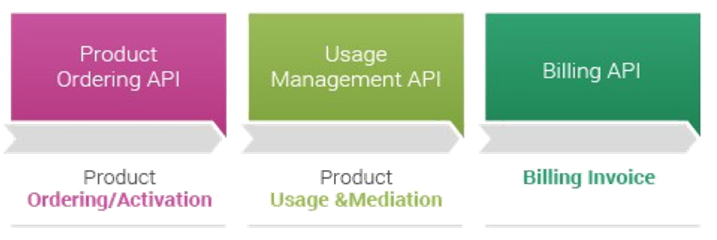

i4Trust Strategy
Laying down the foundation for creation of Data Spaces using open source standard-based technologies
Allowing effective data exchange between “smart applications” that speak the same language (context / digital twin data):
Data exchange API
Standard data models
Data Sovereignty and Trust: common mechanisms for Identification, Authentication and Authorization
Data Marketplace & Publication Services
Alignment with CEF Building Blocks

Slide 11


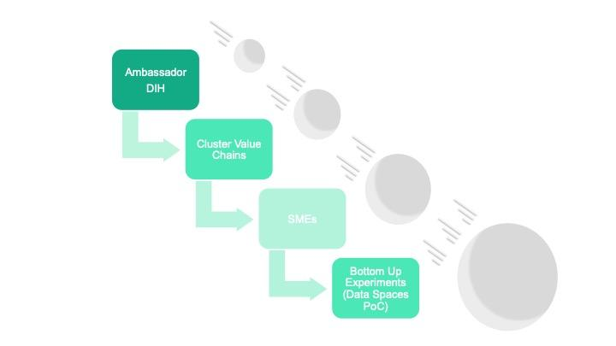

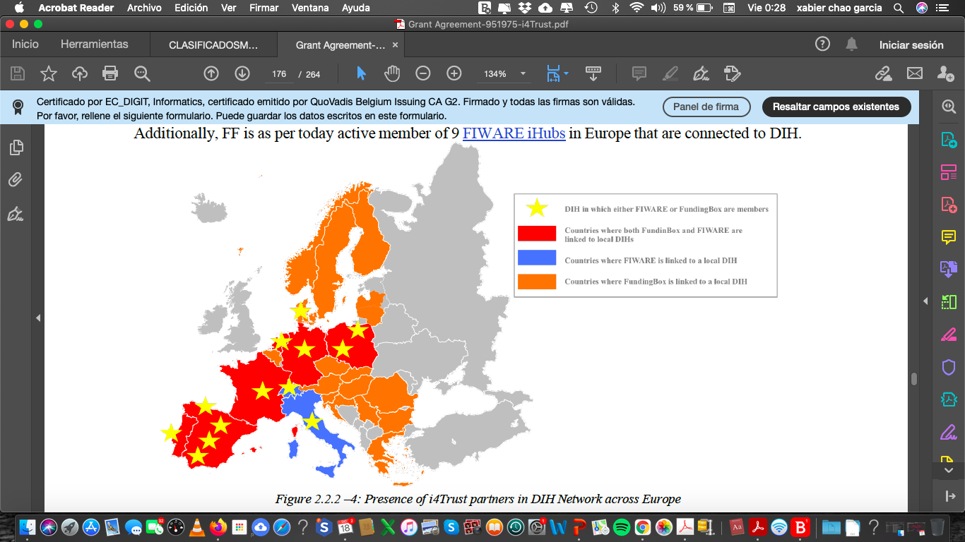
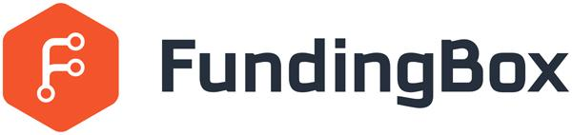
i4Trust Strategy
Going beyond the technology:
a vibrant Community
Training Technical Support
<
32 BuE – 150+ SMEs
(Bottom-up Experiments)
Digital Innovation Hubs (DIHs)
Future experiments
Market solutions
Community
Community Platform Community Mgmt
<

Slide 12







i4Trust Values (our DNA)
TRUSTWORTHINESS
Thanks to the unified framework for identification and the robust legal frameworks that i4Trust brings, you can trust the participants you exchange data with.
SOVEREIGNTY
i4Trust brings the means for enforcing the data access and usage policies you want to define, bringing you the power to be the sovereign of your data.
EFFECTIVENESS
Designed for the exchange of data among Smart Solutions, i4Trust brings a standard data exchange API and data models guaranteeing you to effectively share data
OPENNESS
i4Trust is open, based on open-standard and implemented as Open Source, allowing you to avoid vendor lock-in, thus protecting your investment and reducing costs.
CROSS-DOMAIN
i4Trust unleashes the potential of data sharing among different participants in multiple domains, allowing you to define cross-domain data value chains.
INNOVATION
By combining tools enabling multi-side markets and the ability to monetize data, i4Trust will bring you the opportunity to create innovative business models.
GROWTH
i4trust Community is formed by experts engaged in a process of collective learning and human endeavor to scale your business and gain stronger position in the market.

Slide 13

What benefits will DIHs joining i4Trust gain?
i4Trust allows to materialize the concept of Data Spaces: you will stay at the forefront of the Data Spaces revolution!
Since the i4Trust local expert of a DIH will get certified as a FIWARE expert, that will bring quite a number of advantages beyond participation in the i4Trust Community:
Your DIH would be automatically validated if it wish to be validated as an entity able to provide FIWARE Training and Coaching Services as well as FIWARE Technical Consultancy and Support Services in the FIWARE Marketplace.
If your DIH decides to join the network of FIWARE iHubs, it will be entitled to validate products to be listed in the FIWARE Marketplace. Note that becoming a FIWARE iHub will bring notable benefits in terms of revenue streams (check out the FIWARE iHub brochure)
DIHs trained during the program on iSHARE will also be eligible to become iSHARE implementation partners. Additionally, DIHs could also play one of the iSHARE roles like, iSHARE satellite or iSHARE Authorisation Registry, if they like to.

Slide 14
Introduction to Data Spaces

Slide 15








A data space is an decentralized data ecosystem built by the parties with common purpose
Further, it can be defined as a decentralized data ecosystem built around commonly agreed building blocks enabling an effective and trusted sharing of data among participants.
Data consumers, data providers and identity and authorisation service providers form an ecosystem with a governance structure in place to create a basic data space
Additionally, service providers like Marketplaces, Brokers, Billing and Clearing etc. can be part of data space to support variety of use cases
In i4Trust iSHARE and FIWARE bring the necessary components along with basic governance structure to create the i4Trust data space
Data Space
Data Consumers
Data Providers
Identity and Authorisation service providers
Data Space Governance
Marketplace and other service providers

Slide 16
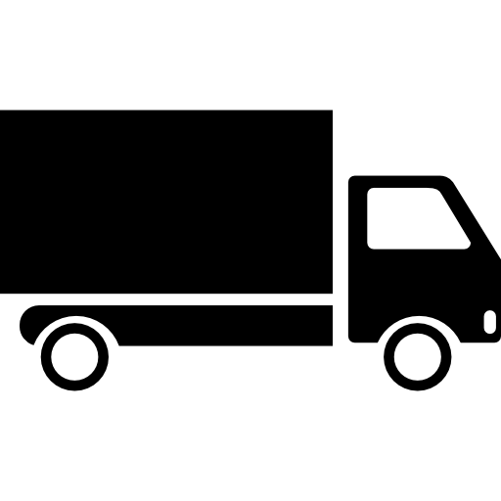
Data spaces are build around real businesses
Agreeing on 1. Data interoperability
2. Data sovereignty 3. Data value creation 4. Governance
Within sectors, verticals the real potential lies to create value through for example
Exchange of hidden data to save time, money and irritation
Allowing AI to run on long value chains to provide new insights
Save emissions

Slide 17
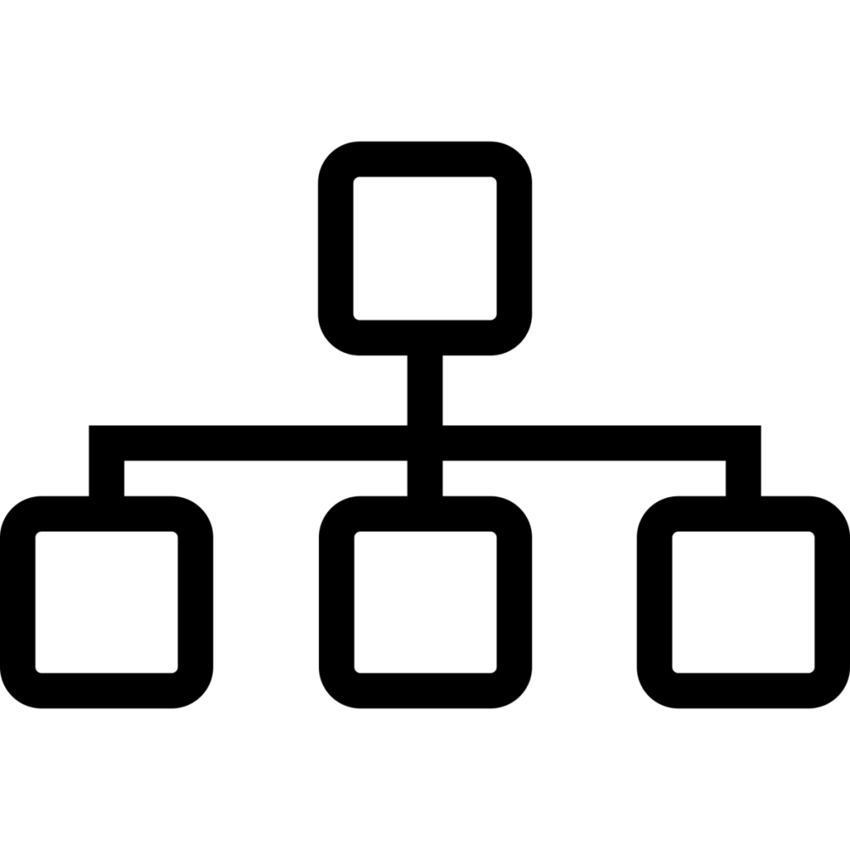







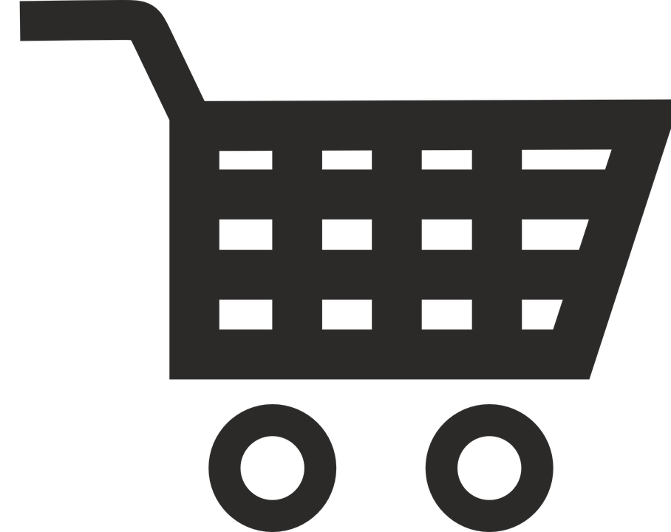




Data Spaces Building Blocks
Data Interoperability
Data Sovereignty and Trust
Data Value Creation
Data Spaces Governance
Data Models & formats
Identity Management
Metadata & Discovery Services
Business Agreements
Data Exchange API
Trusted Exchange
Publication & Marketplace Services
Operational Agreements
Provenance & Traceability
Access & Usage Control/Policies
Data Usage Accounting
Organizational Agreements
Technology Building Blocks

Slide 18
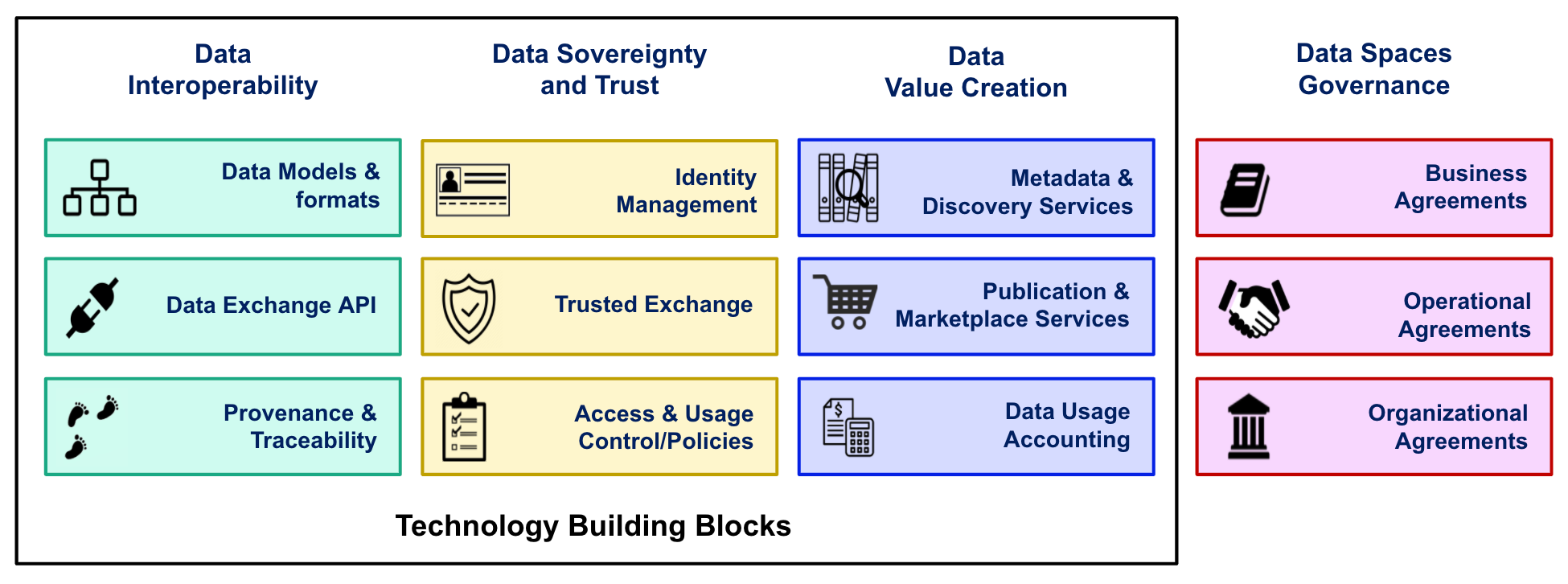
Data space building blocks
Data Interoperability - Data spaces should provide a solid framework for an efficient exchange of data among participants, supporting full decoupling of data providers and consumers.
Data Sovereignty and Trust - Data spaces should bring technical means for guaranteeing that participants in a data space can trust each other and exercise sovereignty over data they share.
Data Value Creation - Data spaces should provide support for the creation of multi-sided markets where participants can generate value out of sharing data (i.e., creating data value chains).
Data Spaces Governance- Data spaces governance should also provide for the non-technical aspects like business agreements, operational agreements and organisational agreements and a governing body for data spaces to provide certainty and sustainability to its participants.
Notes:
Add the icons of the standards used in each block

Slide 19
Examples of data spaces in real life
Data space logistics : saving CO2 and handling time for goods by working under the same trust framework and based on the same standards. And provide ad hoc access to the data of goods in case of emergencies.
Data space Energy : protecting data sovereignty while allowing energy saving services on the data generated by buildings.
Data space building : providing access to the detailed materials needed and on that basis provide a better planning, smoother building process and better insights in the circularity of the build.

Slide 20
How data space building blocks are materialized in i4Trust

Slide 21
i4Trust: open source, mature technologies
Data Interoperability
Data Sovereignty and Trust
Data Value Creation
Data Spaces Governance
Data Models & formats
Identity Management
Metadata & Discovery Services
Business Agreements
Data Exchange API
Trusted Exchange
Publication & Marketplace Services
Operational Agreements
Provenance & Traceability
Access & Usage Control/Policies
Data Usage Accounting
Organizational Agreements
Technology Building Blocks

Slide 22
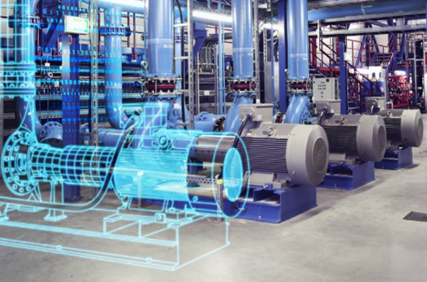

i4Trust: fundamental principles
Fundamental principle in Data Spaces for a Data Economy:
Data providers publish data resources knowing that consumers, unknown “a priori”, know how to consume them
Data consumers know how to discover and consume data resources published by data providers
This requires all participants to “speak the same language”:
Data exchange API (the sentences you construct)
Standard data models (what you speak about)
Common mechanisms for Identity and Access Management (IAM) (who speaks under what rules)
i4Trust focuses on secure exchange between smart applications which exchange context / digital twin data:
Digital Twin = Digital representation of an real-world asset
Digital Twin data = Properties, Relationships
Context = Collection of Digital Twins
IAM at organization and user level, have a Trust Authority
Data Marketplace and Publication services
Smart City
?
Smart Building
Smart Port

Slide 23
What are we referring to as Digital Twin?
Digital Twin = Digital representation of an asset
Characterized by attributes
Properties
Relationships (Linked Data)
Values of attributes may change over time (or not)
Typically have a location (but it is not a must requirement)
(digital representation of) Context = Digital Twins Collection
Cornerstone for the development of interoperable and replicable (portable) Smart Solutions:
Standard API for getting access to Digital Twin data (context)
Common Data Models associated to Digital Twin classes
FIWARE has driven standardization+adoption:
NGSI: ETSI NGSI-LD API (based on initial NGSIv2)
Smart Data Models initiative (500+ data models)

Slide 24








Effective and trusted data sharing
iSHARE Satellite
IdP
Auth
Context Consumers
Smart Building
IdP
Auth
Context Broker
Context Broker
Context Consumers
Smart City
Data Space
Marketplace / Publication Platform
IdP
Auth
Smart Port
Context Broker
Context Producers

Slide 25





Why FIWARE: endorsement at global level
ETSI created Jan 2017 an Industry Specification Group (ISG CIM) for defining a Context Information Management API
FIWARE NGSIv2 provided the basis for the NGSI-LD specs published by ETSI
FIWARE provides several open source implementations of ETSI NGSI-LD
The GSMA has published a Reference Architecture for IoT Big Data Ecosystem which recommends to mobile operators
NGSI-LD plays the core role for the integration of components and the development of applications in the defined Reference Architecture
TM Forum supports FIWARE NGSI for real-time access to context information in cities
TM Forum and FIWARE collaborate in development of data marketplace platform components
TM Forum and FIWARE also collaborate in definition of common data models (smart data models initiative)

Slide 26


Why FIWARE: endorsement at global level
The FIWARE Context Broker Technology (hence, NGSI-LD) is a CEF (Connecting Europe Facility) Building Block recommended by the EC to public and private sector for publication of right-time context data
The European Data portal will support the publication of right-time Open Data
IUDX, which provides the trusted data exchange framework recommended to cities by the government of India, has adopted NGSI-LD as API for data exchange
IUDX will join the smart data models initiative and play a leading role in definition of data models for cities

Slide 27


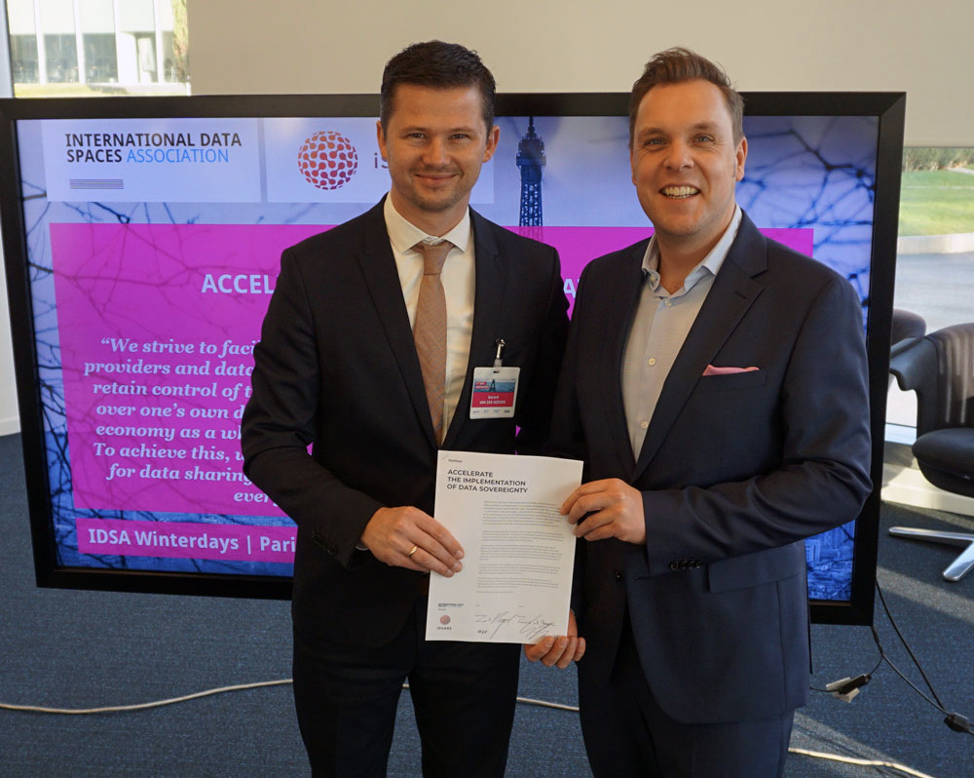

Why iSHARE
Data Sovereignty and trust start with data ownership and knowing the actors in the data space.
iSHARE is the standard for b2b data sharing trust frameworks, allowing cross domain data sharing.
iSHARE is acknowledged by IDSA as the trust framework and Participant registration (PaRIS)
Identities in the framework are based upon CEF building block eIDAS
The Data Sharing Coalition acknowledged iSHARE as the trust framework for data sharing.
iSHARE is totally federated and hence encourages more parties to start a data space on this basis.

Slide 28


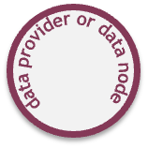

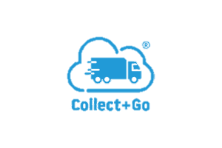









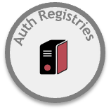






Currently operational in the Dutch Logistics Data space
which In 2021 it already covers the data of over 100.000 companies
Data Space
International Legal Framework governed by iSHARE Foundation

Slide 29
i4Trust: standard-based, CEF Compatible technologies
Data Interoperability
Data Sovereignty and Trust
Data Value Creation
Data Models & formats
Identity Management
Metadata & Discovery
JSON-LD, Smart Data Models
OpenId Connect, OAuth2
DCAT, DCAT-AP
Data Exchange API
Trusted Exchange
Publication & Marketplace
NGSI-LD, Context Broker*
eIDAS*
DCAT, TM Forum Open APIs
Provenance & Traceability
Access & Usage Control
Data Usage Accounting
EBSI*^
JWT, XACML
EBSI*^
(*) CEF Buillding Block (^) planned for 2nd phase
Technology Building Blocks

Slide 30
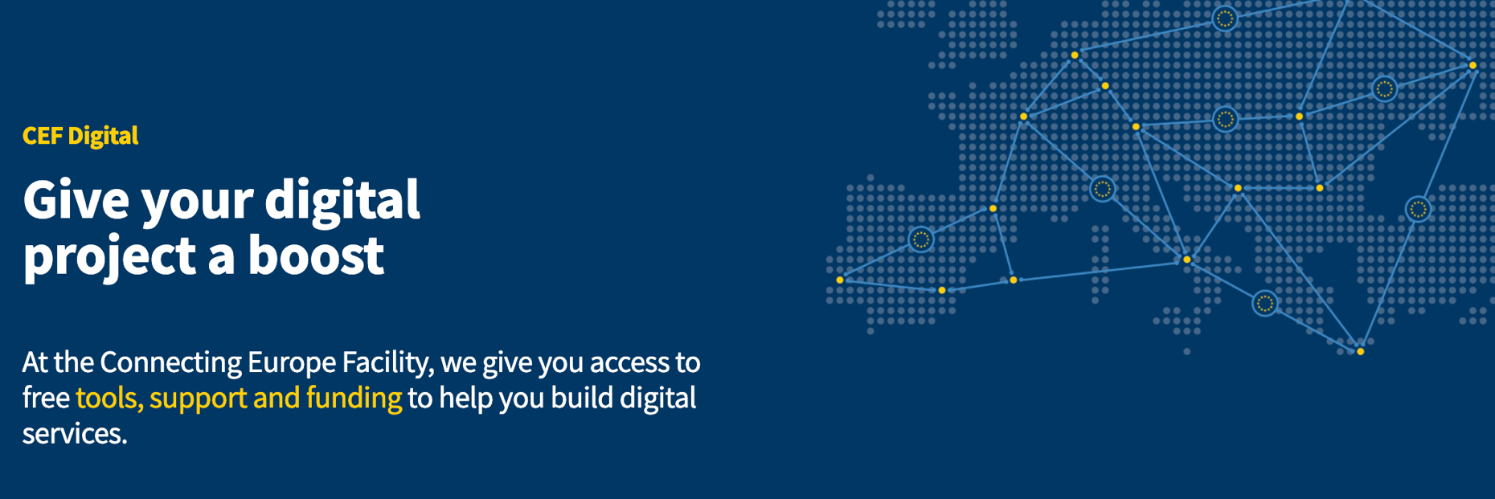



Alignment with CEF Building blocks
eID
Offer services capable of electronically identifying users across Europe
Context Broker
Gather and share data in real-time from all your smart applications and sensors
EBSI
Build the next generation of European blockchain services

Slide 31
Alignment with CEF
eID
iSHARE Satellite
IdP
Auth
Context Consumers
Smart Building
IdP
Auth
Context Broker
Context Broker
Context Broker
Context Consumers
Smart City
Data Space
Marketplace / Publication Platform
IdP
Auth
Smart Port
Context Broker
Context Producers
EBSI

Slide 32
Going beyond building blocks: creation of a vibrant community

Slide 33



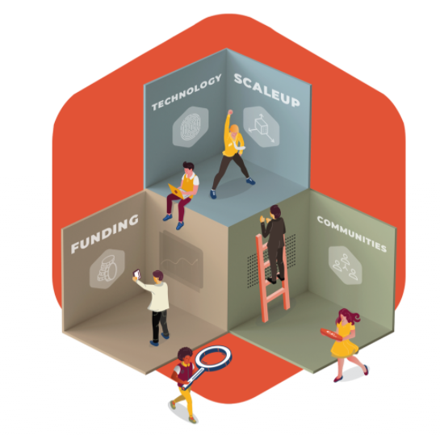
i4Trust Going Beyond the technology
FundingBox
Funding
€ 100 million soft funding
€ 7 million VC
43 programs for startups,
corporates and SMEs
Community
32,000 users in our platform
10,000 users + year
One of the largest EU DeepTech ecosystems
#FundingChampions
your Champion deal
550 Champions
+150 /year
Notes:
Note from JJ: i4Trust DIH Working Group = DIHs que se han registrado interesados en formar parte de la Comunidad i4Trust y que: a) recibirán training durante Abril-Mayo, b) actuarán como embajadores de i4Trust promocionando la Open Call, c) se ofrecerán a SMEs interesadas en aplicar a la Open Call para darles el oportuno training/coaching (eventualmente convertirse en partners de los correspondientes consorcios)

Slide 34
i4Trust Going beyond the technology
Building a vibrant Community
Training Technical Support
<
32 BuE – 150+ SMEs
(Bottom-up Experiments)
Digital Innovation Hubs (DIHs)
Future experiments
Market solutions
Community
Community Platform Community Mgmt
<

Slide 35
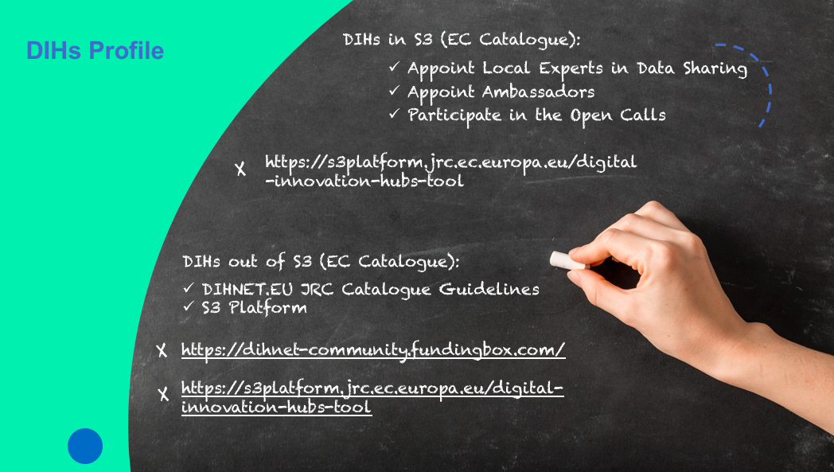
i4Trust Community: DIHs Working Group
Profile of the DIHs joining i4Trust

Slide 36

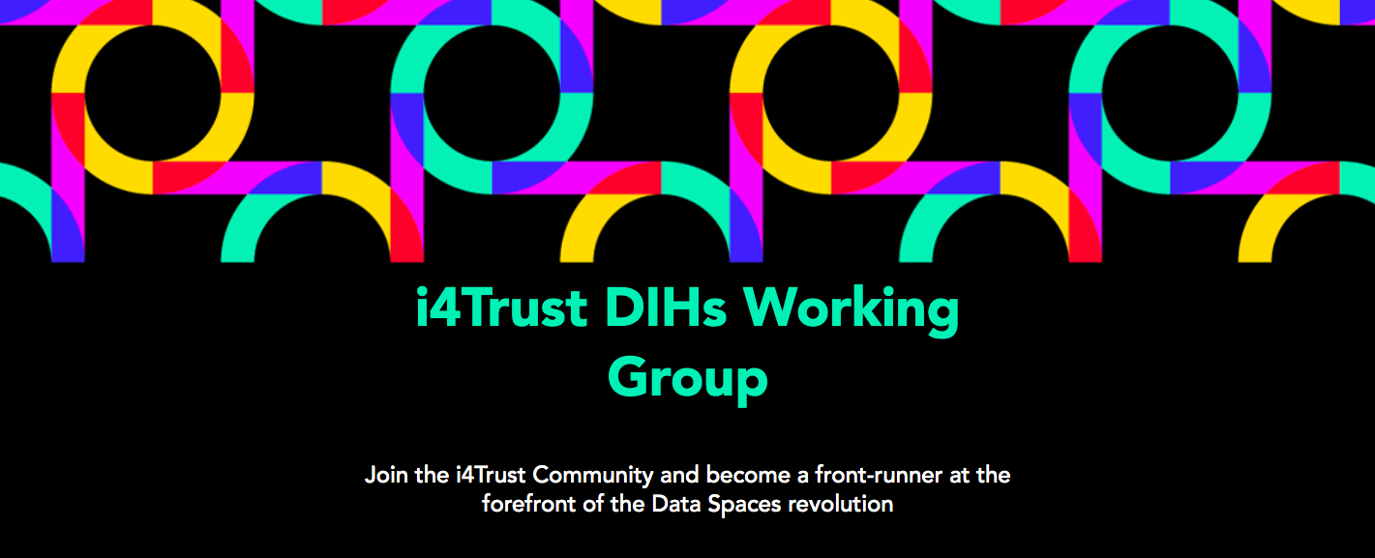
i4Trust Community: Local Experts in Data Spaces
Role of the Local Experts in Data Spaces
Front-Runners at the forefront of the Data Spaces revolution
Gain traction, grow and scale ideas of SMEs in their community and lead developments towards innovative data sharing services.
Support SMEs in the development of the experiments in continuous contact with the International experts from FF and ISF"

Slide 37
i4Trust Community: Ambassador Programme
What is in for you?
Any DIH interested in promoting the mission, vision, business advantages of i4Trust and get training, can appoint an Ambassador.
i4Trust Ambassadors will get global visibility and promotion by means of:
Being part of i4Trust list of Ambassadors
Showcase in i4Trust’s channels local challenges on different domains during the scouting of promising experiments (fostering cross-domain / cross-border experiments)
i4Trust consortium will establish a formal medium/ long-term relationship with any DIH being part of the Ambassador Programme
Become part of the i4Trust community together with the local experts in data sharing
Win-Win
Cooperation
model
Communication Kits per project’s milestone
Visibility in i4Trust channels (logo, links)
Exclusivity (in community activities)
Notes:
added-value proposition & welcome pack

Slide 38
i4Trust Community: Ambassador Programme
Role of the Ambassadors
Advocate of the benefits of i4Trust (free technical trainings, certification, open calls)
Promotion of i4Trust’s Open Calls among SMEs in their regions in order to find the best experiments / solutions eligible for funding (scounting)
The ambassadors will have the role of being an "influencer" among other DIHs thanks to the acquired knowledge during the training
https://i4trust-dihs-group.fundingbox.com/

Slide 39
Scouting: looking for the best experiments on Data Sharing
Stage
1
SMEs awareness
(i4Trust Data Sharing Enablers)
Engaging potential participants
Marketing activities.: online and offline communication / dissemination activities (contribution from i4Trust experts, Ambassadors and LEBDs).
Stage
2
I want to share data
(either get data or send data)
Those with ideas / solutions to solve specific challenges with i4Trust enablers
Meet the experts (Ambassadors, LEBDs and i4Trust Experts)
Common understanding between i4Trust team and participants about the use case. Which issue or solution do they want to solve or enable with i4Trust, both on a data sharing level and IAM level
LEBDs + i4Trust Experts + Data Architect/Business expert from the potential SMEs.
Stage
3
Work out use case
Tiers
Individual scouting
Tier 0: i4Trust Community + help desk
Tier 1: Ambassadors preselection of promising use cases
Tier 2: LEBDs co-create and fine tuning the use case, including connecting additional SMEs to the Use Case
Tier 3: LEBDs introduce the cross-value chain and the cross-border aspects when needed.
Notes:
Identity and Access Management

Slide 40
i4Trust Open Calls in numbers
2 Open calls
32 Bottom-Up Experiments
150 SMEs
32 DIHS
€3.2 million
Equity free funding
9-MONTH
Mentoring Programme

Slide 41

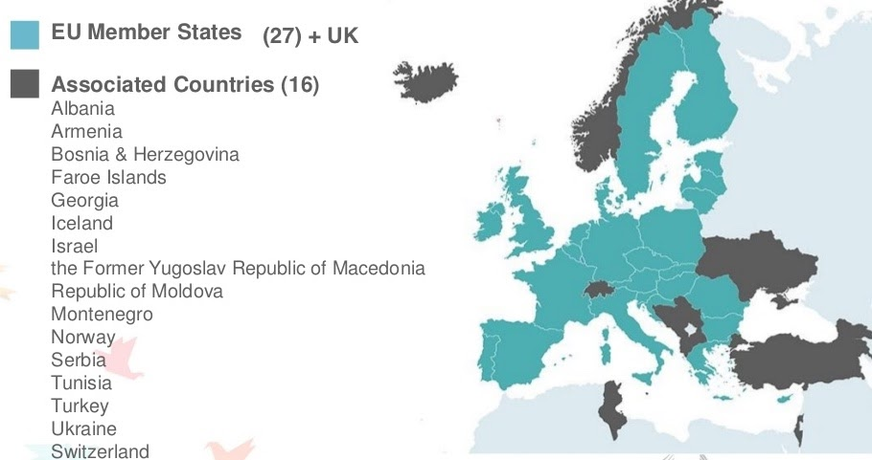
i4Trust Open Call
Who are we looking for?
Consortia composed by SMEs/slightly bigger companies and DIHs registered in any of the following countries:
Member States of the European Union
Associated Countries to H2020
The United Kingdom
Minimum of 4 entities per proposal are compulsory: 3 SMEs/slightly bigger companies + 1 DIH.
1 DIH
Min. 3 SMEs

Slide 42
i4Trust Open Call
Which kind of experiments are we looking for?
Those implementing effective data sharing among companies in one or more cross-value chains
Real-life challenges solved through data sharing with business and/or societal impact
Implementing FIWARE+iSHARE technology framework to solve specific challenges
All requirements will be listed in the Open Call and evaluation criteria in the Guide for Applicants
DIHs joining i4Trust Community and engaged with a certified local expert will be listed as DIHs that interested parties may contact to get support and, eventually, incorporate in their consortium
DIHs can use i4Trust channels to promote concrete local challenges and application domains
1 DIH
Min. 3 SMEs

Slide 43
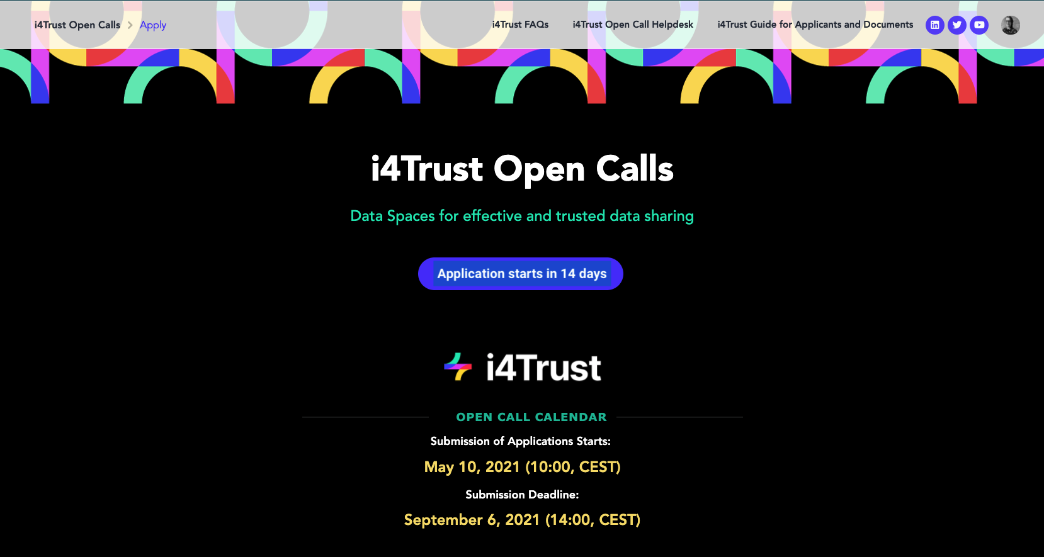
i4Trust Open Call: How to apply?
https://i4trust-open-call.fundingbox.com/
Notes:
An SME will be considered as such if it complies with the Commission Recommendation 2003/361/EC.

Slide 44
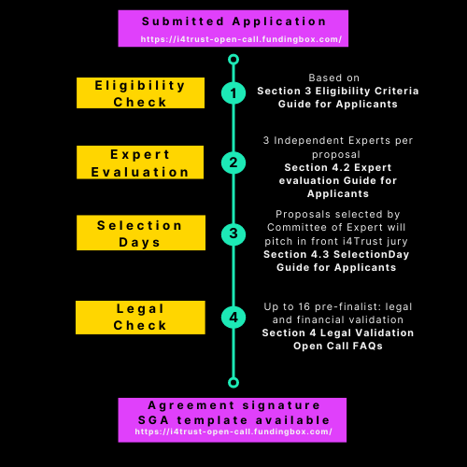
i4Trust Selection and Evaluation Process

Slide 45

Timeline
DIHs as ambassadors
Scouting of experiments
Selection of experiments
i4Trust training
from April 26, 2021
to May 21, 2021
i4Trust 1st Open Call
i4Trust platform ready (Apr 1st)
i4Trust OC1 closes (06/09/21 - 14:00 CEST)
i4Trust experiments (begin 4Q2021)
From 10/05/21 - 10:00 CEST
to 09/09/21 - 12:00 CEST

Slide 46
Time for break!

Slide 47
Session 2 - Introduction to i4Trust Data Spaces
Speakers:
Juanjo Hierro - CTO FIWARE Foundation
Gerard van der Hoeven - Executive Director iSHARE Foundation
Rajiv Rajani - CTO iSHARE Foundation

Slide 48
Go level deeper into i4Trust building blocks for data spaces

Slide 49
Data Spaces Building Blocks
Data Interoperability
Data Sovereignty and Trust
Data Value Creation
Data Spaces Governance
Data Models & formats
Identity Management
Metadata & Discovery Services
Business Agreements
Data Exchange API
Trusted Exchange
Publication & Marketplace Services
Operational Agreements
Provenance & Traceability
Access & Usage Control/Policies
Data Usage Accounting
Organizational Agreements
Technology Building Blocks

Slide 50
i4Trust: standard-based, CEF Compatible technologies
Data Interoperability
Data Sovereignty and Trust
Data Value Creation
Data Models & formats
Identity Management
Metadata & Discovery
JSON-LD, Smart Data Models
OpenId Connect, OAuth2
DCAT, DCAT-AP
Data Exchange API
Trusted Exchange
Publication & Marketplace
NGSI-LD, Context Broker*
eIDAS*
DCAT, TM Forum Open APIs
Provenance & Traceability
Access & Usage Control
Data Usage Accounting
EBSI*^
JWT, XACML
EBSI*^
(*) CEF Buillding Block (^) planned for 2nd phase
Technology Building Blocks

Slide 51
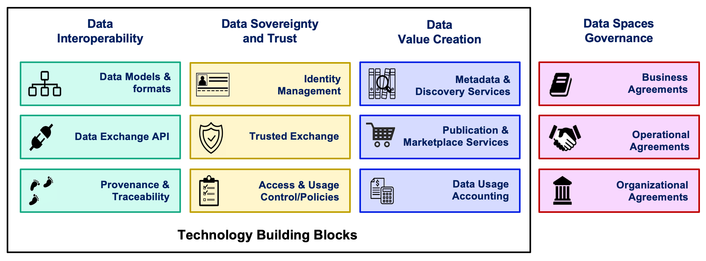
Data Interoperability

Slide 52
What are we referring to as Digital Twin?
Digital Twin = Digital representation of an asset
Characterized by attributes
Properties
Relationships (Linked Data)
Values of attributes may change over time (or not)
Typically have a location (but it is not a must requirement)
(digital representation of) Context = Digital Twins Collection
Cornerstone for the development of interoperable and replicable (portable) Smart Solutions:
Standard API for getting access to Digital Twin data (context)
Common Data Models associated to Digital Twin classes
FIWARE has driven standardization+adoption:
NGSI: ETSI NGSI-LD API (based on initial NGSIv2)
Smart Data Models initiative (500+ data models)

Slide 53



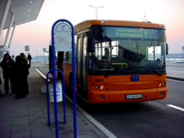
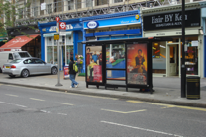


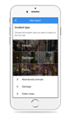
Data Exchange API: ETSI NGSI-LD
Application/Service
Shop
Location
Business name
Franchise
offerings
FIWARE NGSI API (NGSIv2 → NGSI-LD)
Citizen
Birthday
Preferences
Location
ToDo list
Context Broker
Entities (Digital Twins)
Bus
Location
No. passengers
Driver
Licence plate
Shop
Location
Business name
Franchise
offerings
Incident / claim
Date
Location
Type
Issuer
Description
Citizen
Name-Surname
Birthday
Preferences
Location
ToDo list
Bus
Location
No. passengers
Driver
License plate
Attribute

Slide 54
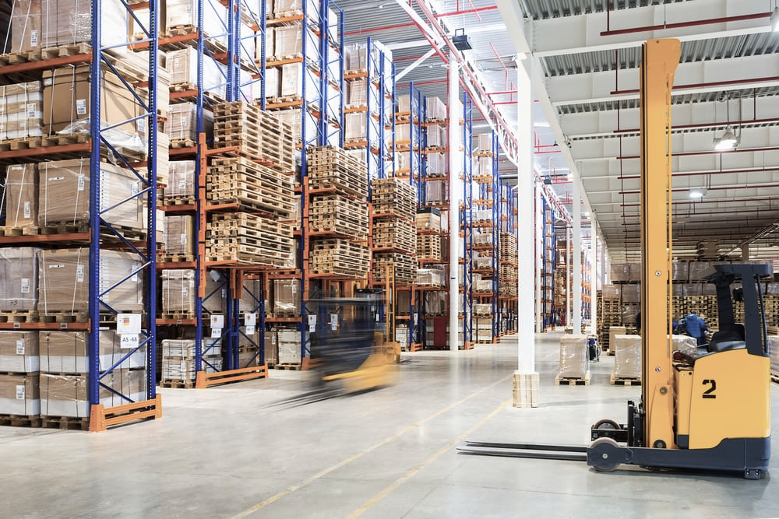
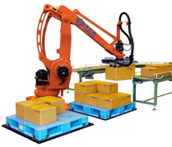
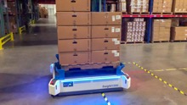

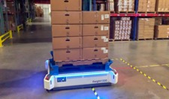



Data Exchange API: ETSI NGSI-LD
Application/Service
FIWARE NGSI API (NGSIv2 → NGSI-LD)
Palletizer robot
id
product
Items quantity
Layers
Size
Weight
Transport robot
Id
location
speed
transported items
destination
Context Broker
Entities (Digital Twins)
Transport robot
Id
location
speed
transported items
destination
Palletizer robot
Id
product
Items quantity
La<yers
Size
weight
Operator
Id
Location
Assigned task
Profile
Operator
Id
location
assigned task
profile
Shopfloor Door
Id
location
status (open/close)
Attribute

Slide 55

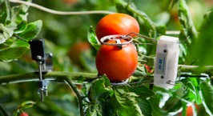
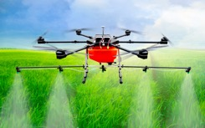





Data Exchange API: ETSI NGSI-LD
Application/Service
FIWARE NGSI API (NGSIv2 → NGSI-LD)
Crop
Humidity
Leaf area
Age
Drone
Location
Battery level
Speed
Planed route
Context Broker
Entities (Digital Twins)
Tractor
Location
Speed
Planed route
Drone
Location
Battery level
Speed
Planed route
Tractor
Location
Speed
Planed route
Crop
Humidity
Leaf area
Age
Attribute
‹#›

Slide 56








Data Exchange API: ETSI NGSI-LD
Application/Service
Patient
id
location
patient record
treatment
FIWARE NGSI API (NGSIv2 → NGSI-LD)
Surgery Room
id
hospital
equipment
surgery plan
Doctor
id
specialties
location
visits plan
Context Broker
Entities (Digital Twins)
Ambulance
license plate
location
speed
equipment
current alert
Surgery Room
id
hospital
equipment
surgery plan
Hospital
name
address
total patient rooms
occupied patient rooms
total surgery rooms
occupied surgery rooms
Ambulance
License plate
location
speed
equipment
current alert
Alert
alert id
emergency level
description
location
patient id
Attribute
‹#›

Slide 57





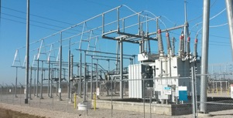
Data Exchange API: ETSI NGSI-LD
Application/Service
Energy Storage
active power
reactive power
SoC
SoH
FIWARE NGSI API (NGSIv2 → NGSI-LD)
Context Broker
Entities (Digital Twins)
Wind Turbine
location
power
wind speed
pitch angle
Wind Turbine
location
power
wind speed
pitch angle
Smart Home
location
address
installed PV
energy consumption
Substation
Hi voltage
Lo voltage
nominal power
power flow
Wind Plant
Location
Active Power
Reactive Power
Frequency
Attribute

Slide 58
Data Exchange API: ETSI NGSI-LD
Application/Service
NGSI-LD is a simple yet powerful REST API
Simple: simple operations are rather simple, what you would expect in a RESTful API
Entity types, entities, attributes have a path
You perform standard GET, POST, PUT, PATCH, DELETE operations
Yet powerful: powerful operations supported
Geo-queries
Subscription / Notification
Pull/Push styles for gathering data
Multiple data ”renderings” (key value, normalized, GeoJSON)
Temporal operations
Federation mechanisms
FIWARE NGSI API (NGSIv2 → NGSI-LD)
Context Broker
Wind Turbine
location
power
wind speed
pitch angle
Smart Home
location
address
installed PV
energy consumption
Wind Plant
Location
Active Power
Reactive Power
Frequency

Slide 59
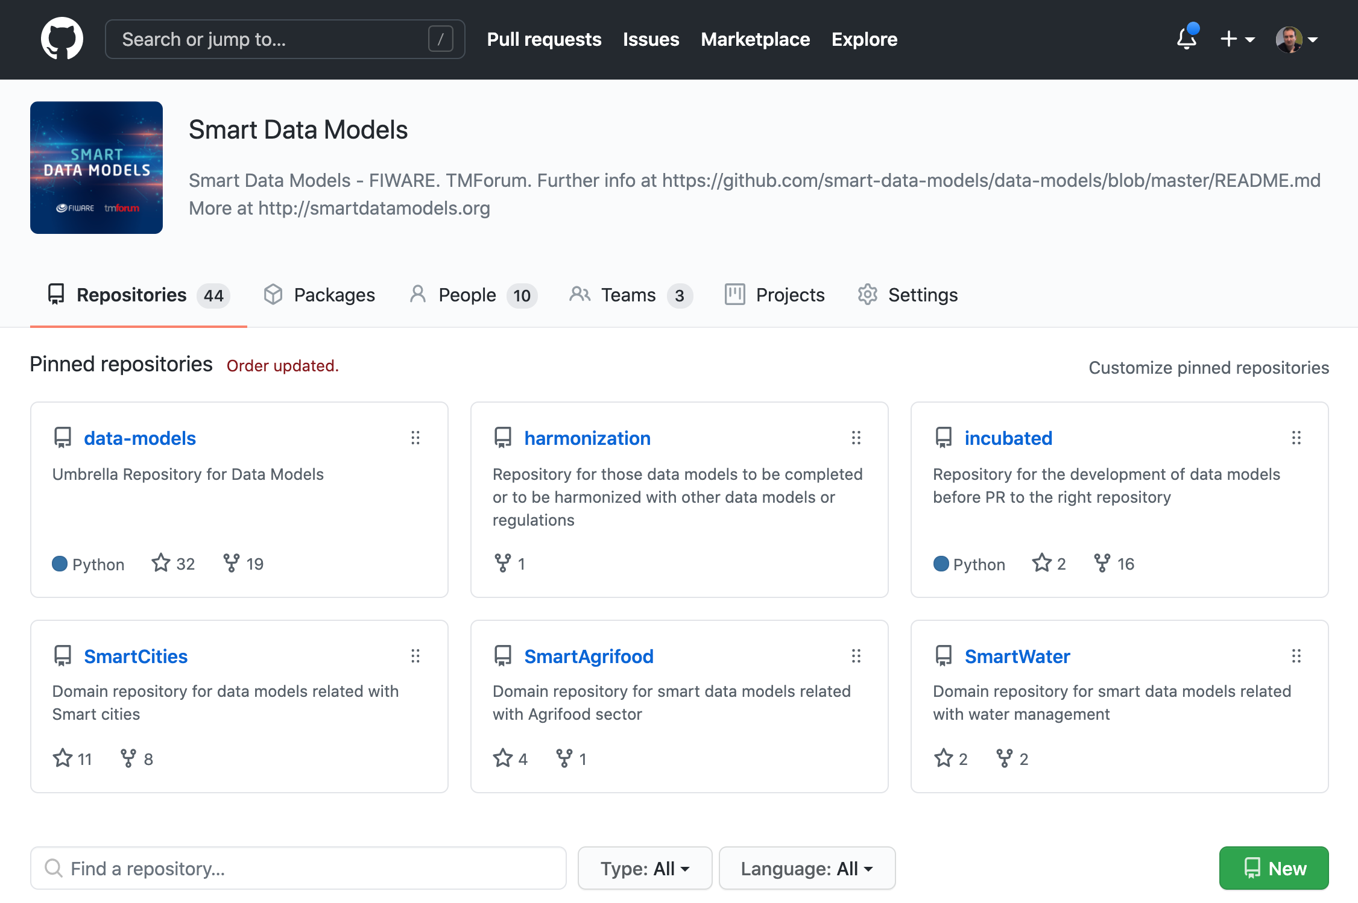
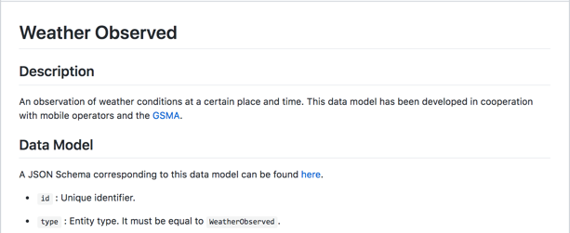
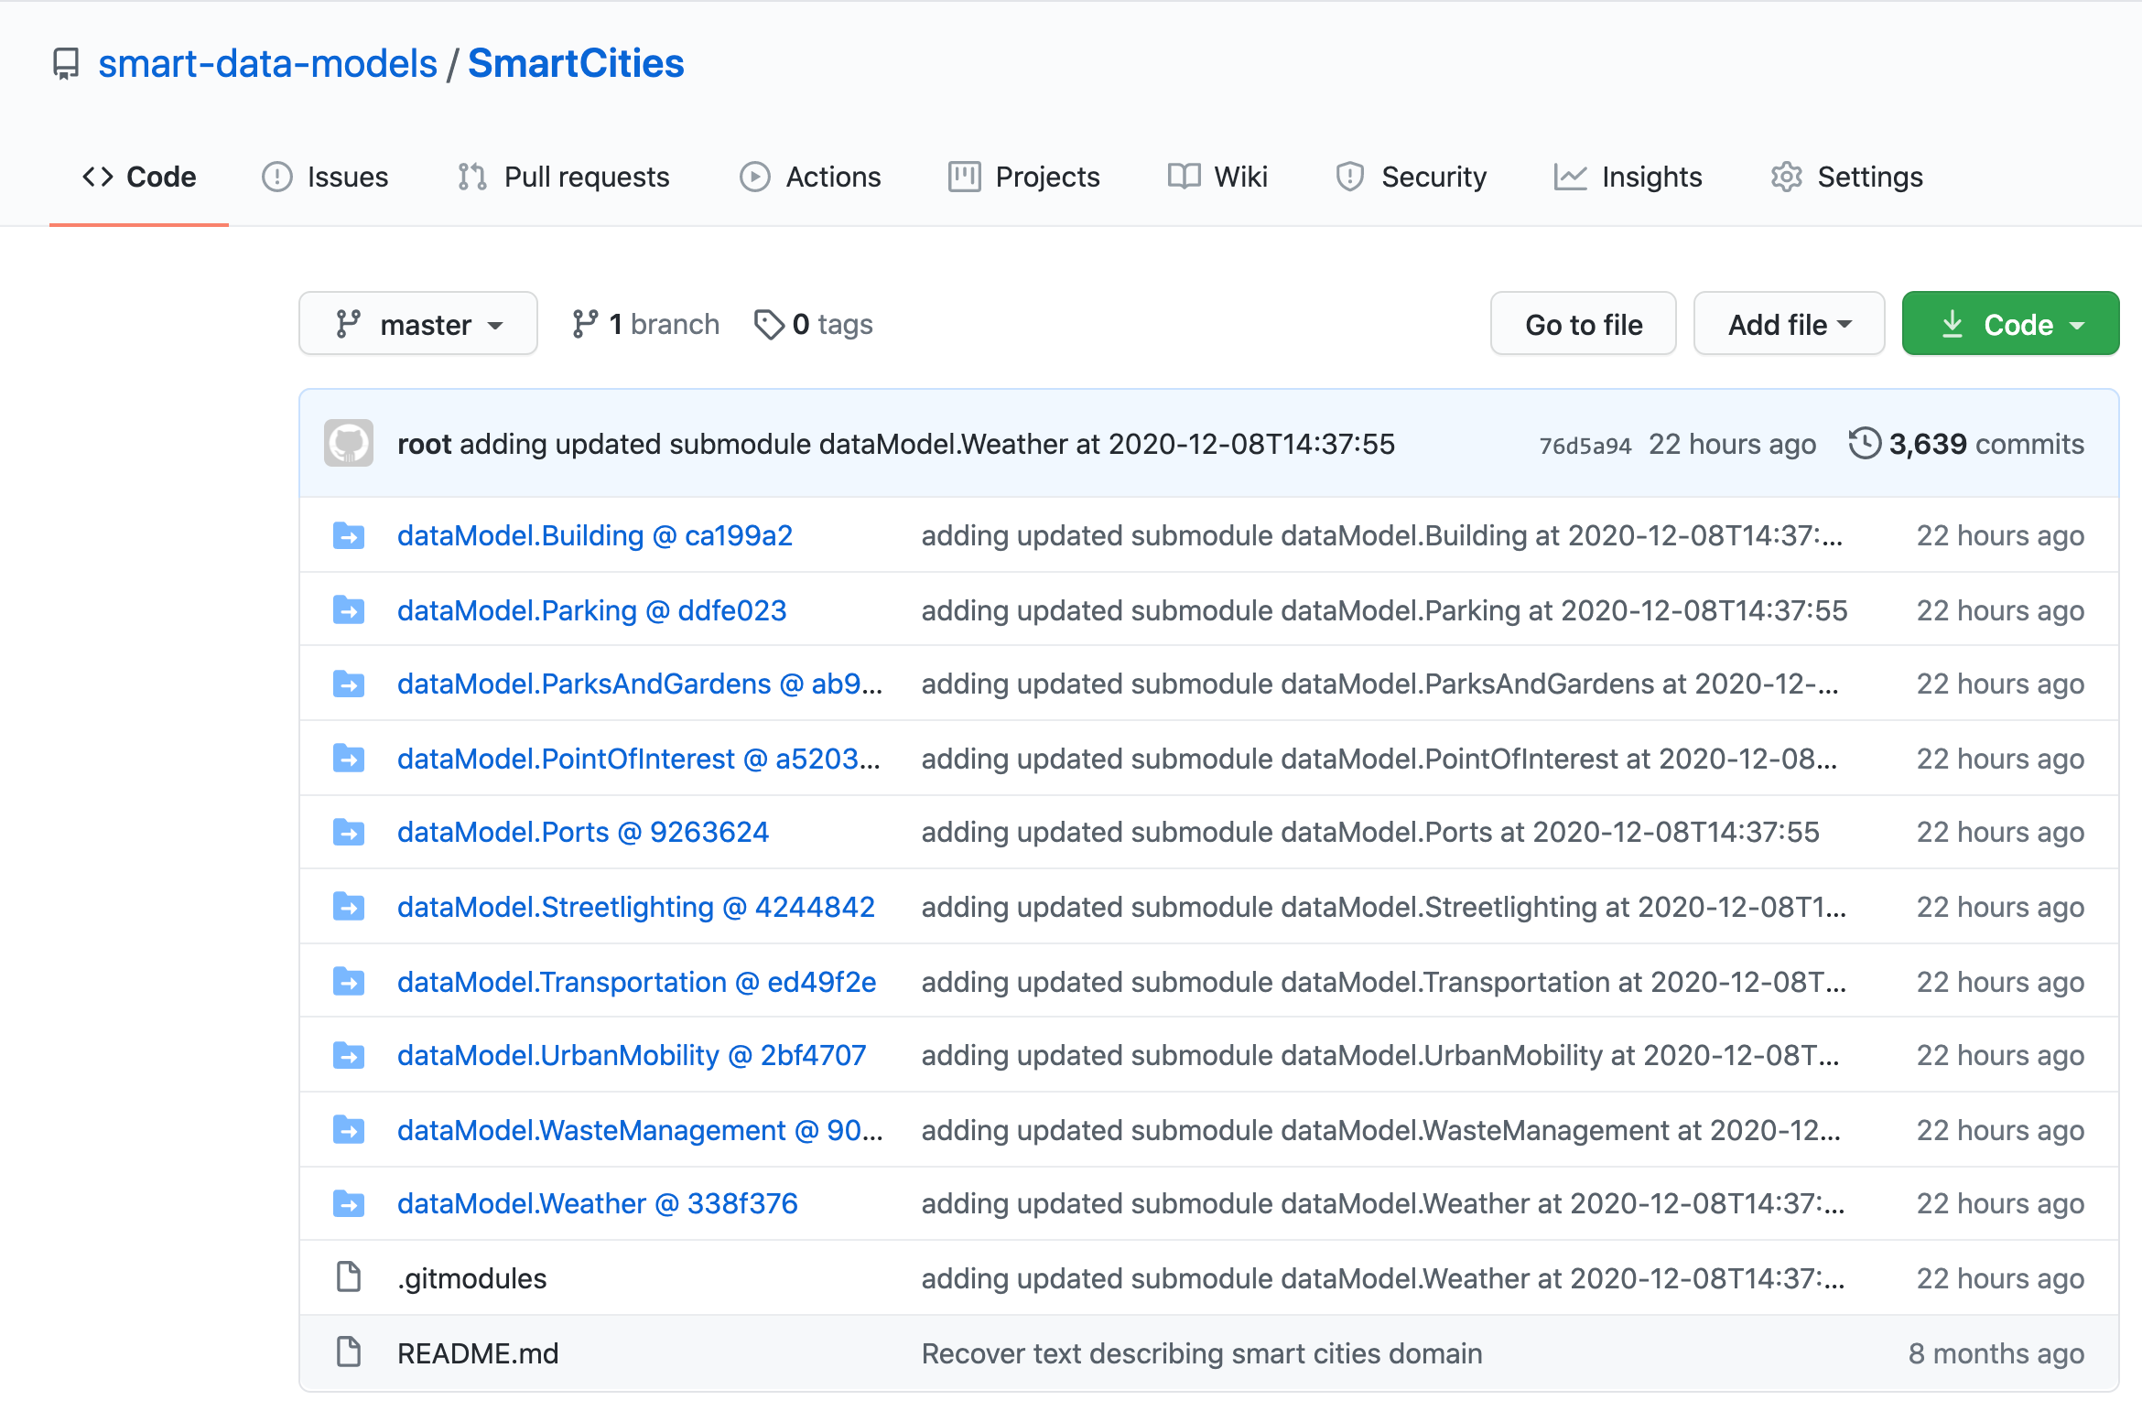
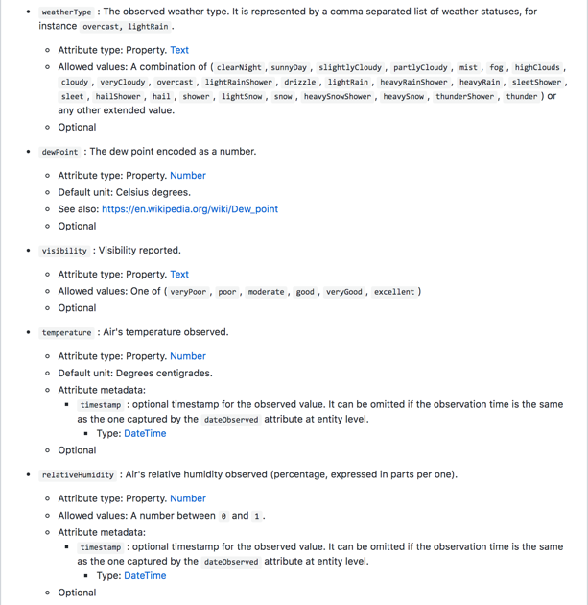
Smart Data Models
FIWARE Foundation is collaborating with relevant organizations towards definition of common data models for multiple application domains
Smart Cities
Smart Health
Smart Energy
Smart Environment
Smart Manufacturing
…
Defined data models rely on well-established ”de-facto” standards (schema.org, SAREF, IEC CIM in Energy, UNE 178503 for Tourism, …)
Provides JSON/JSON-LD Mappings compatible with NGSIv2/NGSI-LD also useful for other RESTful APIs
https://github.com/smart-data-models

Slide 60
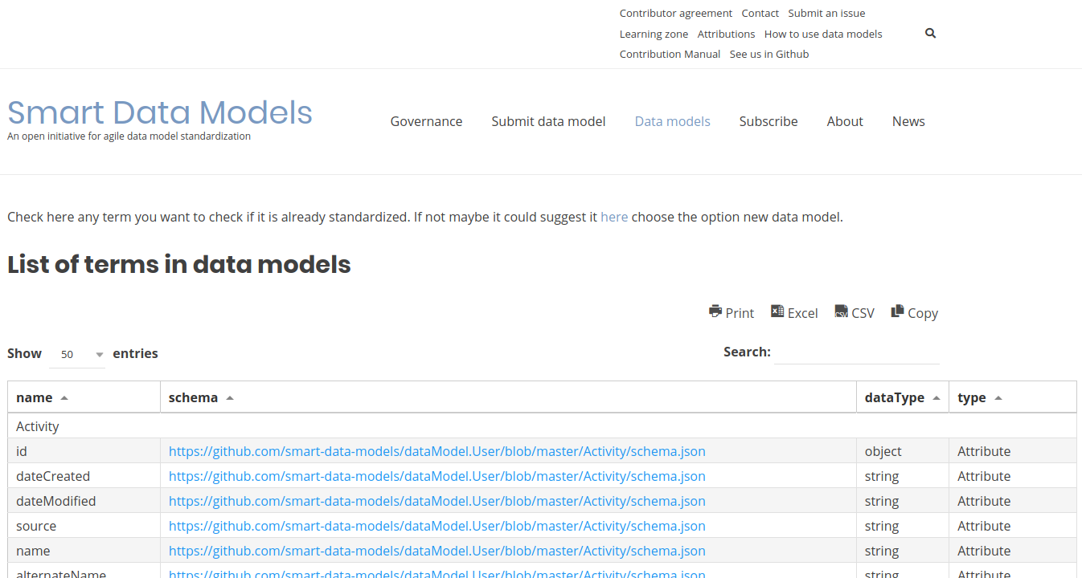
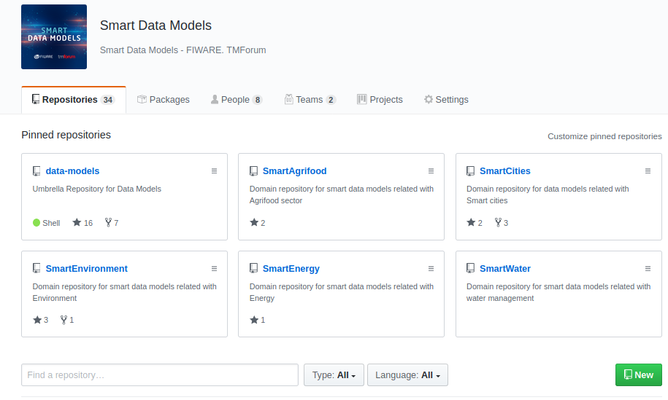
Smart Data Models: Webs
GITHUB
http://github.com/smart-data-models
WEBSITE (Wordpress)
http://smartdatamodels.org
Oriented to developers
All resources available
Contribution by PR
Issues on data models
Oriented to end users
News on updates (subscription)
Check attributes and enumerations

Slide 61



Smart Data Models: domains and subjects
DATA-MODELS
Guides for coding new data models
Template for new data models and examples
Directory for scripting tools to check data models
Inventory of domains and data models
Inventory of attributes and terms
@Context for json-ld
data-models
Umbrella repo
DOMAINS REPOSITORIES
Readme pointing to the list of subjects
General info or shared resources
Smart Water
Smart Cities
Smart
Environment
Cross Sector
Smart
Destinations
Smart
Agrifood
Smart
Energy
Smart
Manufacturing
Smart
Aeronautics
Smart
Robotics
SUBJECTS’ REPOSITORIES
Subject 1
(sewage)
Subject 2 (parking)
Subject 3 (weather)
Subject 4 (Power Transformer)
Readme pointing to the list of data models for the objects
Contributors.md
subject-schema.json
DATA MODELS
LIFECYCLE MANAGEMENT REPOSITORIES
README.md
/doc/spec.md
/examples
schema.json
Adopters
LICENSE
Incubated
Harmonization

Slide 62
Data Sovereignty and Trust

Slide 63

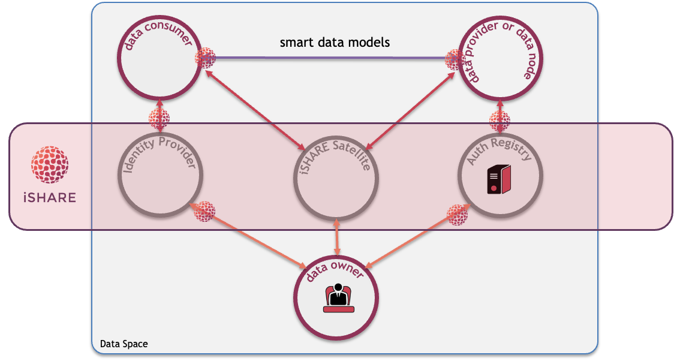
Data sovereignty and trust: principles
Identity and access/control policies should be handled:
At organization level (participants)
At the level of users of applications within each organization
Identity, Authentication and Authorization based on standards:
OpenId Connect
OAuth2
XACML
There will be a trust authority that certifies what organizations are considered trusted parties in a data space
Model should work assuming there is no single global Identity Provider and Authorization Registry, each organization may have:
A certified Identity Provider of its own choice for managing identity of end users
Its own Authorization Registry (XACML PMP/PAP server)
Its own XACML PEP proxy and PDP server

Slide 64
iSHARE is a legal framework providing legal assurance….
International Legal Framework governed by iSHARE Foundation

Slide 65
…utilising existing identities that are available in a dataspace…
Data Space or Domain
International Legal Framework governed by iSHARE Foundation

Slide 66
..and iSHARE standards allowing data owners to authorise other to access their data fields
Data Space or Domain
International Legal Framework governed by iSHARE Foundation

Slide 67
.. and iSHARE satellites guarding the trust in the dataspace.
Data Space or Domain
International Legal Framework governed by iSHARE Foundation

Slide 68
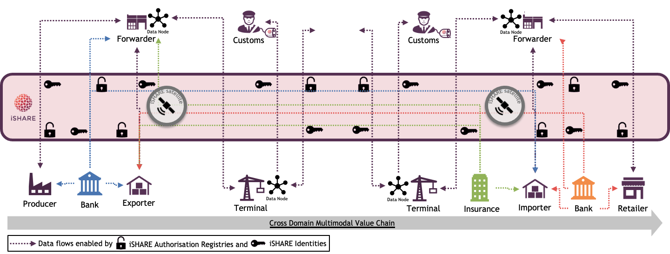
…thus enabling Cross Domain trusted data sharing

Slide 69
Data sovereignty and trust: components
FIWARE security components comply with standard-based iSHARE specifications and can be hosted locally to each participant for a better performance:
FIWARE Keyrock can serve both as Identity Provider and Authorization Registry (XACML PMP/PAP server)
FIWARE API umbrella can serve as XACML PEP proxy and PDP server
Alternatively, participants may rely on any certified iSHARE Identity Provider and Authorization Registry services
The certified iSHARE Satellite service acts a Trust Authority

Slide 70
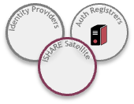
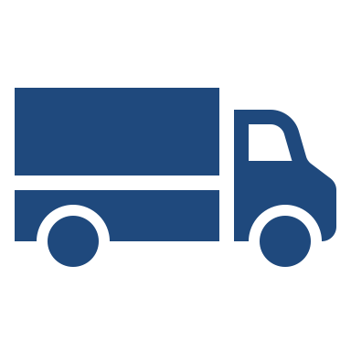




Other data spaces are live of being formed, form a good starting point for experiments
Dutch Logistics
Belgian Logistics
Building
Financials
Energy

Slide 71


Because iSHARE is an open and federated trust framework and standard ..
…anyone within the trust requirements can setup an iSHARE Satellite to have Data Sovereignty and Trust covered for a new dataspace and/or domain.
iSHARE satellites allow to to define operational agreements and governance within the dataspace for
Data Interoperability
Data Value Creation
Governance
Hence, great building block for i4Trust participants setting up new dataspaces!

Slide 72
Data Value Creation

Slide 73

Data Marketplace Services
Data Marketplace Services:
Supports the definition of offerings around digital assets (data files, right-time data access/processing services are handled as such)
Integrated with Identity Management and Data Usage Policy Management frameworks
Relying on TM Forum Business Ecosystem Open APIs to manage lifecycle of digital assets and monetization
Data providers can instantiate their own marketplace or rely on global independent Marketplace services
Advanced pricing and revenue sharing support:
Basic models: free, one-time, recurring, pay-per-use
Dynamic pricing: fees, discounts
Product terms and conditions:
Licenses, terms and conditions
Service Level Agreements (SLAs) metrics

Slide 74


Data Publication and Discovery/Brokering Services
Data Publication Services:
Data portal supporting DCAT-AP and publication of data resources linked to offerings in the Marketplace
Harvesting of data from Open Data Portals
Data Discovery/Brokering services:
Metada linked to description of data resources based on DCAT-AP standard
NGSI-LD as basis for discovery of data resources (modeled as entities with DCAT-AP properties)

Slide 75
Data Spaces Governance

Slide 76










Data licenses in iSHARE legal framework create trust about who does what with data after it has been shared
Under iSHARE, it is possible to provide explicit instructions about the conditions under which data can be exchanged
iSHARE Participants can hold each other to licenses because they have all signed the same agreement with the iSHARE satellite – thus creating a network of trust
Using data licenses eliminates the need to have fixed business agreements, which are usually bilateral agreements and often time and resource consuming
For example: you, as the recipient of my data, may only make use of this data for one month and may NOT share it with others

Slide 77


iSHARE provides operational agreements and service levels for all its certified roles as foundation
Operational agreements determine how the data space will be operated and what service levels can be expected. This is necessary for parties to trust the ecosystem to commit and be part of.
Operational agreements include but are not limited to agreements like which parties are responsible for providing which services and their corresponding levels.

Slide 78



Governance is key for optimum operation and future sustainability of both i4Trust and data spaces it creates
FIWARE governance structure drives strategic and technical direction make sure that the technology evolves to serve their needs
The governance of iSHARE and FIWARE will be key for the i4Trust projects and will be compatible
iSHARE has governance structure in place to make sure that it remains operational and trust is preserved in network for its participants

Slide 79
Summary of roles in i4Trust

Slide 80


Roles in a Data Space
Data Space
Trust Provider
Data Consumer
Data Provider
Data Owner
Identity Provider
Marketplace
Authorisations Provider
Notes:
Though these roles are mentioned separately, it does not restrict an organization from playing multiple roles.
Trust Provider: Every data space needs a trust provider who acts as register of participants of the data space and keeps their status up to date. In a large data space there can be more than one trust provider. In i4Trust this role will be fulfilled by iSHARE satellite.
Data sharing roles:
Data Consumer: A party or person who consumes data provided by the data provider. The data consumer has to agree to use the data as defined by the data license under which it received the authorization to access that data.
Data Provider: A organization that hosts service to provide data on behalf of data owners. Data provider has responsibility to verify who the data consumers are and provide only data that they are authorized to have access to.
Data Owner: A party or person who owns the data in the context of the process at a given time. Do note that data owner does not have necessarily have to be data creator.
Service Provider roles:
Identity Provider: A service provider that provides authentic human identities of data consumers or data providers so that either of them can be sure that they are dealing with the right party. Identity provider also provides the level of assurance of the identity.
Authorisations Provider: A service provider that provides services to data owners to register authorisations to data consumers/data providers. Alternatively, a data owner could chose to play the role themself as long as they host the authorisation provider APIs
Marketplace: A service provider which allows data owner to publish data available for data consumers to be purchased or publish services data consumers can purchase. Marketplace enables discovery of data for data consumers.

Slide 81



Roles in i4Trust complies to iSHARE and FIWARE
Data Space
Trust Provider
iSHARE Satellite
Data Consumer
Data Provider
Context Broker
Data Owner
Identity Provider
(Keyrock)
Marketplace
FIWARE Marketplace
Authorisations Provider
(Keyrock)
Notes:
As you can see from picture that for each role iSHARE enables those roles to interact with each other using the trust framework and FIWARE provides the technology and solution to effectively share data in a data space in i4Trust.
The trust provider role is as role defined by iSHARE satellite which acts as participant register
The data consumer is the organization or person consuming service/data via a service provided by data provider while identifying itself using standards defined in iSHARE which allows them to connect to any data provider who is also iSHARE enabled.
The data provider can provide data to data consumer as authorized by data owner and FIWARE context broker technology provides intelligence and context information needed to make data meaningful.
The data owner can register authorizations over its data and specify the conditions under which data is shared which data consumer must abide by. When shared using the iSHARE trust framework the data consumer is legally obliged to use data in accordance with the conditions specified.
The Marketplace provided by FIWARE technology allows data providers and data owners to list data and/or services to offer which data consumers can buy/subscribe to. On the other hand data consumers can find offerings of relevant data from multiple data providers/owners. Besides, marketplace can act as clearing house and broker when required between the parties exchanging data so that data sharing transactions can be logged at 3rd party for auditing and billing purposes.
The identity provider role deals with the human identities with varying level of assurances as defined in eIDAS framework to support various use cases. Depending on the criticality of the data, appropriate level of assurance for identity can be provisioned.
The authorizations provider is a role which can be played by any organization as defined in iSHARE. The role only defines the interface for asking about authorizations and how the response should look like. The authorizations can be determined by using a policy database and/or transactional data from backend systems and/or existing authorizations from LDAP/AD or a combination thereof. Keyrock powered by FIWARE will provide a policy database to define policies for authorizations which can be combined with other sources to determine authorization during runtime.

Slide 82

Trust Provider essentially facilitates trust in a data space and acting as a guardian
Every data space needs a trust provider who acts as register of participants of the data space and keeps their status up to date
They follow predefined and agreed upon procedures to maintain the list of participants
Since they play important role in a data space it is paramount that trust provider is a neutral party or a party providing this service within the confines of strict agreements on neutrality
Every data space should have one trust provider at minimum, however, same trust provider organisation can provide service in multiple data spaces
In a large data space there can be more than one trust provider
In i4Trust this role will be fulfilled by iSHARE satellite role
Trust Provider

Slide 83



i4Trust enables data sharing among parties in an effective, trusted and secure way
Data Consumer is a role played by organisation or a person who is interested in data at other party either for its own use or to provide services to the data owner/data provider
It needs to handle data it receives in accordance to the conditions set by the data owner
Data Provider is role played by organisation who provide data via means of service or portal
Data Provider relies on data owner to provide with authorizations and usage rights for the data it shares with data consumer
Data Owner is the party who has right over the data in given context and time
It provides with authorizations, so data consumer can get access to data
In i4Trust, data owner also can specify the conditions under which data is shared, thereby providing it with data sovereignty
Data Consumer
Data Provider
Data Owner

Slide 84

Identity Provider role is designed for users to reuse their existing identity provider at various service/data providers
Identity Provider
The Identity Provider role deals with the human identities with varying level of assurances, as defined in eIDAS framework, to support various use cases
Depending on the criticality of the data, appropriate level of assurance for an identity can be requested
iSHARE specifications are designed such that service/data provider does not necessarily need to pre-register an identity provider as it can verify if it is an iSHARE certified provider from iSHARE satellite
Keyrock an Identity Provider software from FIWARE already complies with iSHARE specifications and is available as open source

Slide 85

Authorisations Provider is a role which can be played by any organization as defined in iSHARE
Authorisations Provider
The role only defines the interface for asking about authorizations and how the response should look like.
The authorizations can be determined by using a policy database and/or transactional data from backend systems and/or existing authorizations from LDAP/AD or a combination thereof.
Keyrock powered by FIWARE will provide a policy database to define policies for authorizations which can be combined with other sources to determine authorization during runtime.

Slide 86

Marketplace allows discovery and monetization of data and services in a data space
Marketplace
The Marketplace provided by FIWARE technology allows data providers and data owners to list data and/or services to offer which data consumers can buy/subscribe to.
On the other hand, data consumers can find offerings of relevant data from multiple data providers/owners.
Besides, marketplace can act as clearing house and broker when required between the parties exchanging data so that data sharing transactions can be logged at 3rd party for auditing and billing purposes.

Slide 87




Additionally, other service providers can provide specific services within a data space
Data Language Vocabulary Provider
Authorisations Provider Broker
Data Broker
Identity Provider Broker
Clearing Houses
Data Model Translation Provider

Slide 88
Closing of session

Slide 89


i4Trust – why to join
Level of maturity of iSHARE and FIWARE building blocks
Existing ecosystems around iSHARE and FIWARE
iSHARE:
5 K+ participants managing data
45 K+ identities sharing that data
FIWARE:
90+ organization members, 270+ individual members
150+ product offerings, 150+ cities adopting FIWARE
growing market successes in other sectors
Strategic alignment with EC CEF Digital program
Opportunity to join a vibrant Community where to share knowledge and best-practices
Opportunity to become FIWARE iHub and iSHARE partner
Be recognized as a front-runner !!

